Slide 1

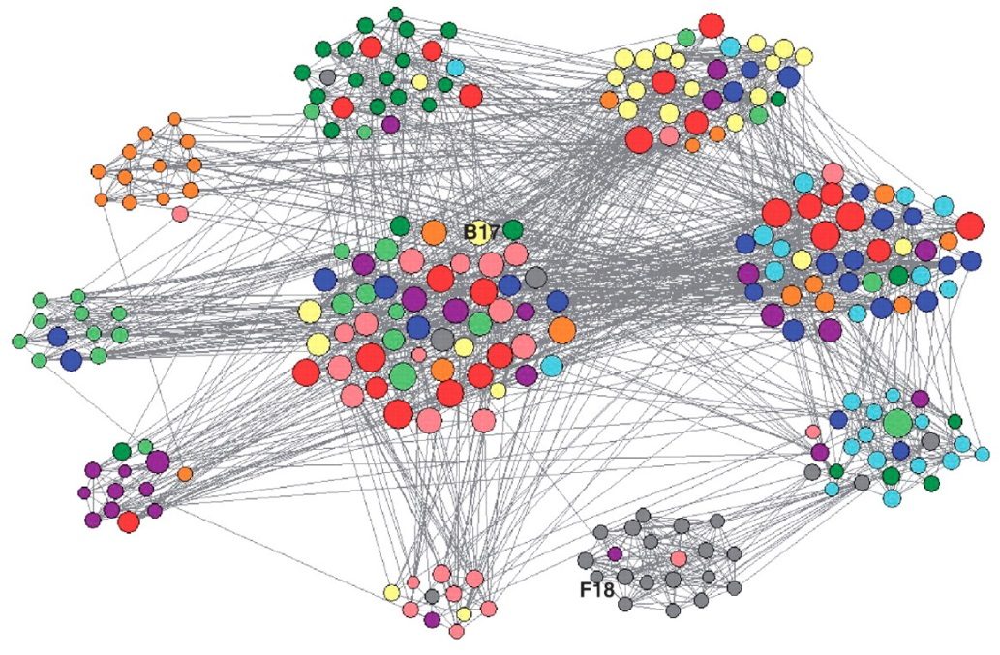
Customer Behavior Simulation
with
Agent Based Modelling
DSA 5900
Professional Practice
(1 Credit)
Gowtham Talluru
Advisor: Dr. Charles Nicholson
Notes:
Good Afternoon Everyone
My Practicum topic is Customer Behaviour Simulation using ABM

Slide 2


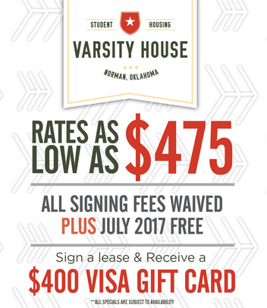


Motivation
Simulate the behavior of tenants (Customers) and Landlords (Vendors) during marketing period using Agent Based Modelling.
Understand the behavior of market in various Demand and Supply scenarios.
Identify better pricing strategies for Landlords
Notes:
I got motivation for this study from the situation of students….
There is kind of more supply than demand and apartments are giving many offers to get as many leases as possible. You can see
From last two years, I have been observing the pricing strategies followed by apartment complexes and thought of making ABM to understand the behavior of the market
Objectives of the study is to

Slide 3
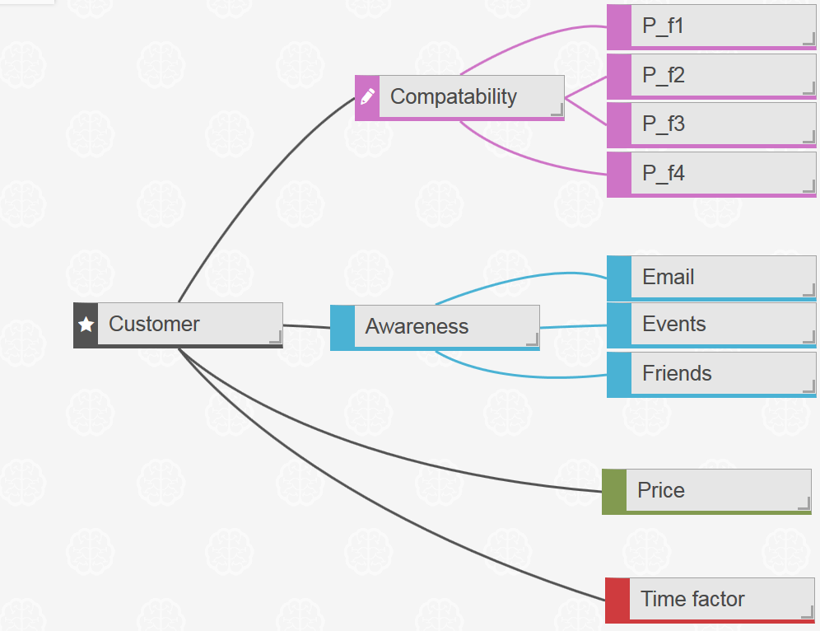
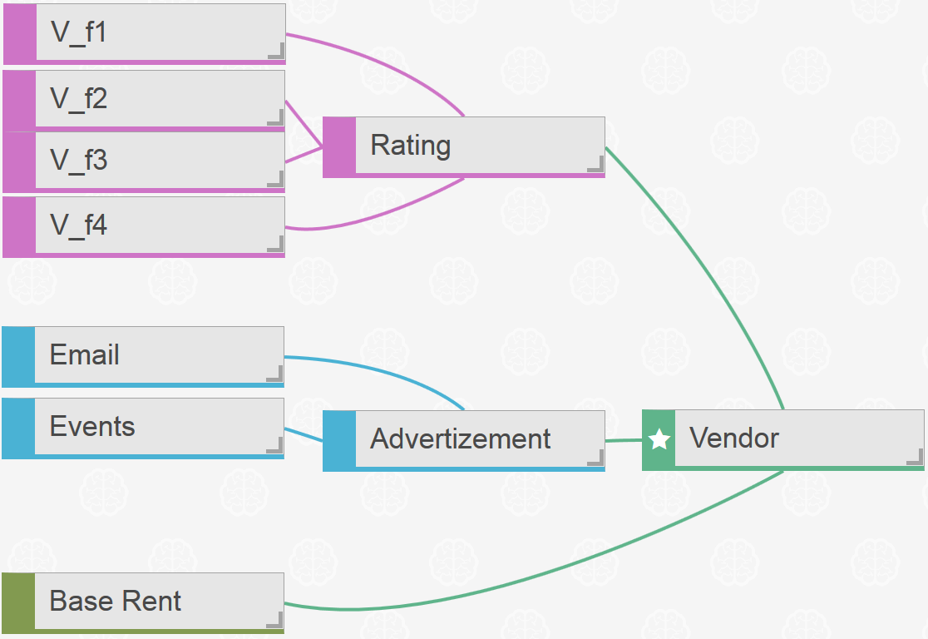

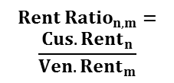
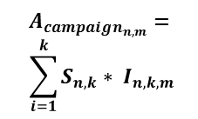




Agent Based Model
$$C_{nXm}=$$
$${Cs}_{n,f} X {Vn}_{f,m}$$
$$A_{campaign_{n,m}}=$$
$$\sum_{i=1}^{k}{S_{n,k}∗ I_{n,k,m}}$$
$$Rent Ratio_{n,m}=$$
$$\frac{Cus. Rent_{n}}{Ven. Rent_{m}}$$
Marketing period start
Customer Passive
Customer becomes Active
Critical
$$C_{n,m}>C_{threshold}$$
$$Rent Ratio_{n,m}>R_{threshold}$$
$$Total score_{n,m}=\left({αC}_{n,m}+{βA}_{campaign_{n,m}}+γA_{social_{n,m}}\right)∗ {\left(Rent Ratio_{n,m}\right)}^{δ}$$
$$A_{n,m}>A_{threshold}$$
Notes:
The customer population is characterized by
When the marketing period starts customer

Slide 4

Marketing Period
$$Prefered Rent=\left(P_{f1}+ P_{f2}+ P_{f3}+ P_{f4}+ p_{f5}\right)∗customer expectation$$
$$Vendor Base Rent=\left(V_{f1}+ V_{f2}+ V_{f3}+ V_{f4}\right)∗vendor expectation$$
$$Rent_{start}=Base Rent∗Starting Price Factor$$
$$Rent_{phase}=Rent_{start}∗\left(\frac{Occupancy_{phase}}{\frac{Capacity}{No of Phases} ∗Target Fraction }\right)$$
No of Marketing Phases
1
2
3
4
5
Notes:
3. The pricing strategy of vendors is governed by two factors.
a) One is Starting Price Factor which relates rent at the start of marketing season to base rend.
b) Another factor governing pricing strategy is Target Fraction.
Vendors can distribute the number of leases they have evenly among marketing phases.
Or if they want to go aggressive they can target to fill all the leases by mid of marketing season
4. Target fraction will be one if the vendors target to sign
5. At each phase if the occupancy is more than the target

Slide 5
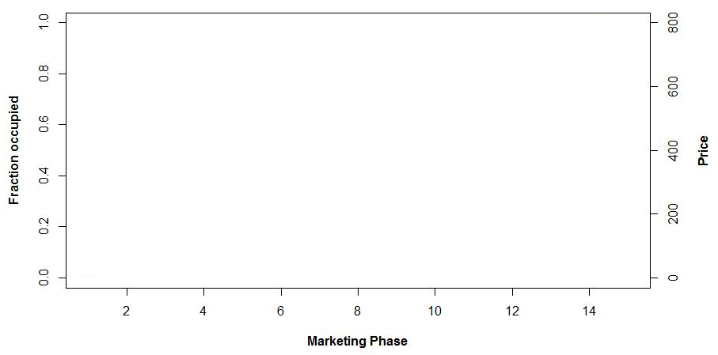

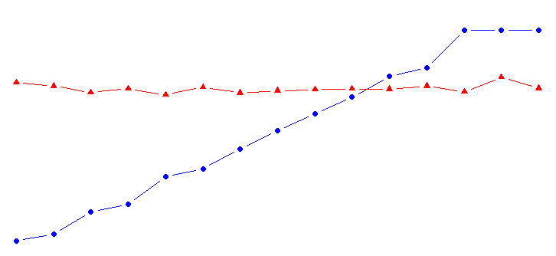
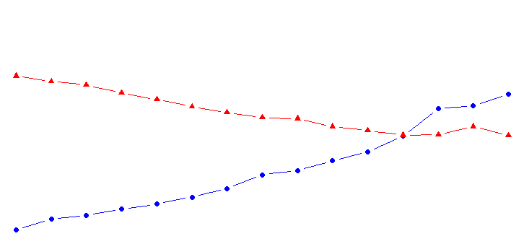
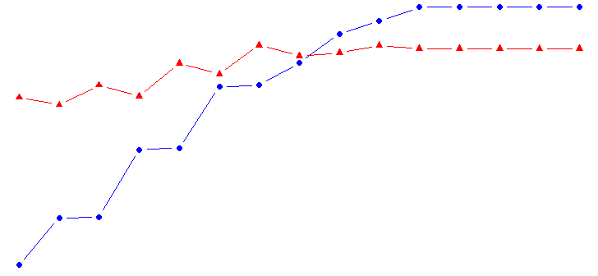




Base Case
Demand = Supply
Demand < Supply
Demand > Supply
$$Starting Price Factor=1$$
$$Customer Expectation=8$$
$$Target Fraction=1$$
$$Vendor Expectation=11$$
Notes:
In the base case both Starting Price Factor and Target fraction are kept 1
The question is weather the

Slide 6
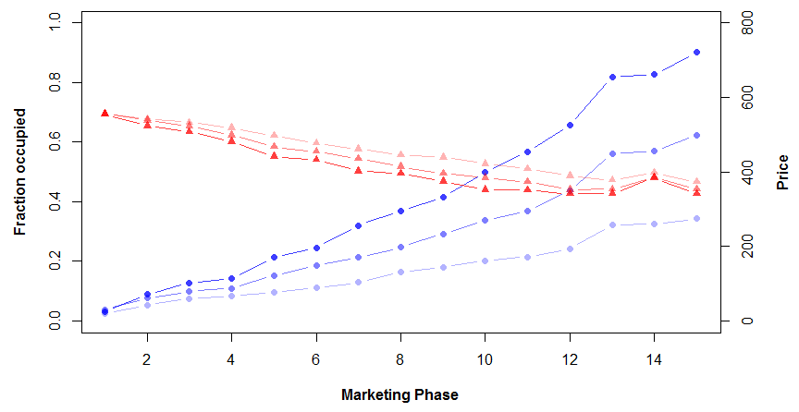


Pricing strategy if Demand < Supply
$176k
Demand < Supply
$128k
$76k
$$Starting Price Factor=1$$
$$Target Fraction=1.3, 1, 0.7$$

Slide 7
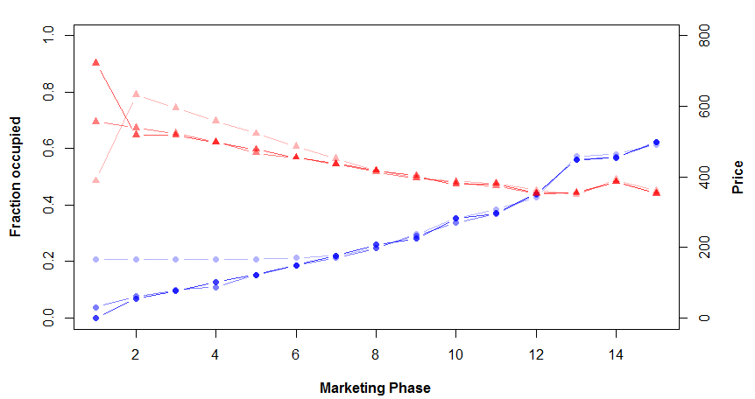


Pricing strategy if Demand < Supply
$127k
Demand < Supply
$128k
$116k
$$Starting Price Factor=1.3, 1, 0.7$$
$$Target Fraction=1$$

Slide 8
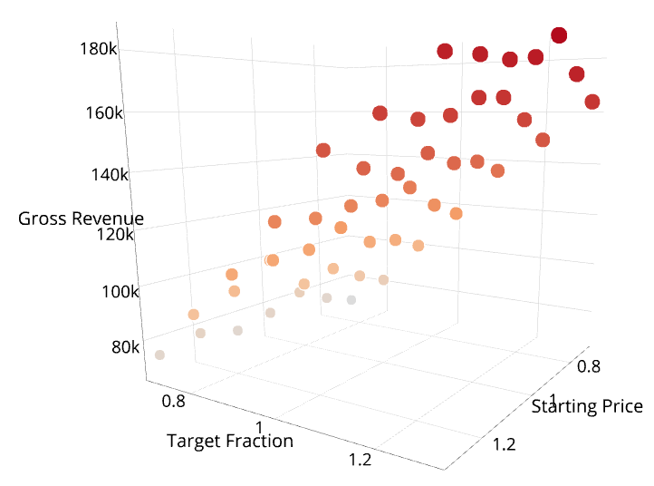
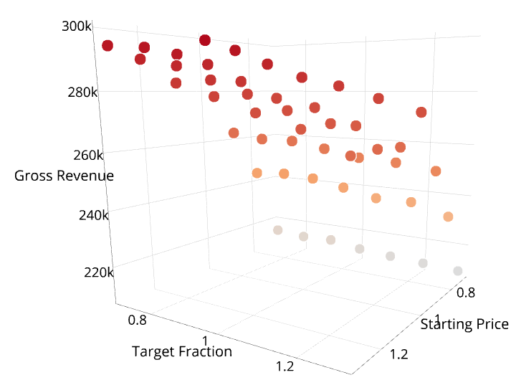
Optimum Pricing Strategy
Demand < Supply
Demand > Supply
Max (1.3, 0.9, $ 184k)
Max (0.7, 1, $ 299k)

Slide 9
Conclusions
Agent Based Modelling can be used to simulate the market behavior of tenants and landlords in different demand and supply scenarios.
When demand is less than supply, ( Starting price factor 0.9 and Target fraction 1.3 ) resulted in maximum revenue.
When demand is more than supply ( Starting rent factor 1 and Target fraction 0.7) resulted in maximum revenue

Slide 10
QUESTIONS
ANSWERS
&

Slide 11
Customer Attributes

Slide 12
Vendor Attributes

